Slide 1
Introduction of this course
李宏毅
Hung-yi Lee
Notes:
1、Introduction of this course
01_introduction.pptx
参考书
“Machine Learning” (ML) 和 “Machine Learning and having it Deep and Structured” (MLDS) 有何不同？
Speech Recognition 语音识别
Image Recognition 图像识别
Playing Go 下围棋
Dialogue System 对话系统
Goodness of function f 函数优度 f
Regression 回归
Classification 分类
Binary Classification 二元分类
Multi-class Classification 多类分类
Spam filtering 垃圾邮件过滤
Document Classification 文档分类
Linear Model 线性模型
Non-linear Model
Deep Learning 深度学习
Convolutional Neural Network (CNN) 卷积神经网络（CNN）
SVM, decision tree, K-NN … SVM、决策树、K-NN……
Supervised Learning 监督学习
Semi-supervised Learning 半监督学习
Transfer Learning 迁移学习
Data not related to the task considered (can be either labeled or unlabeled) 与考虑的任务无关的数据（可以标记或不标记）
Unsupervised Learning 无监督学习
Machine Reading: Machine learns the meaning of words from reading a lot of documents without supervision 机器阅读：机器无需监督，通过阅读大量文档来学习单词的含义
Structured Learning 结构化学习
Beyond Classification 超越分类
Speech Recognition 语音识别
Machine Translation 机器翻译
Reinforcement Learning 强化学习
Learning from critics 向批评家学习
scenario 设想

Slide 2
李宏毅的個人網頁：http://speech.ee.ntu.edu.tw/~tlkagk/courses_ML17.html
Notes:
1、Introduction of this course
01_introduction.pptx
参考书
“Machine Learning” (ML) 和 “Machine Learning and having it Deep and Structured” (MLDS) 有何不同？
Speech Recognition 语音识别
Image Recognition 图像识别
Playing Go 下围棋
Dialogue System 对话系统
Goodness of function f 函数优度 f
Regression 回归
Classification 分类
Binary Classification 二元分类
Multi-class Classification 多类分类
Spam filtering 垃圾邮件过滤
Document Classification 文档分类
Linear Model 线性模型
Non-linear Model
Deep Learning 深度学习
Convolutional Neural Network (CNN) 卷积神经网络（CNN）
SVM, decision tree, K-NN … SVM、决策树、K-NN……
Supervised Learning 监督学习
Semi-supervised Learning 半监督学习
Transfer Learning 迁移学习
Data not related to the task considered (can be either labeled or unlabeled) 与考虑的任务无关的数据（可以标记或不标记）
Unsupervised Learning 无监督学习
Machine Reading: Machine learns the meaning of words from reading a lot of documents without supervision 机器阅读：机器无需监督，通过阅读大量文档来学习单词的含义
Structured Learning 结构化学习
Beyond Classification 超越分类
Speech Recognition 语音识别
Machine Translation 机器翻译
Reinforcement Learning 强化学习
Learning from critics 向批评家学习
scenario 设想

Slide 3
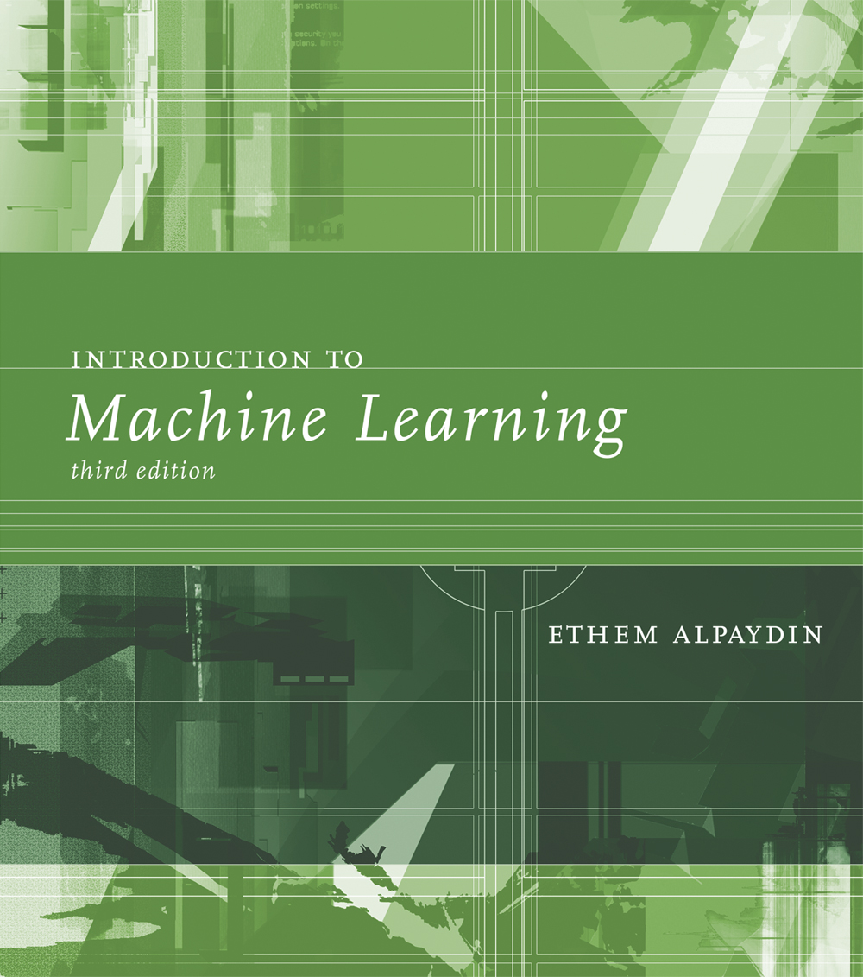

參考書籍
Notes:
1、Introduction of this course
01_introduction.pptx
参考书
“Machine Learning” (ML) 和 “Machine Learning and having it Deep and Structured” (MLDS) 有何不同？
Speech Recognition 语音识别
Image Recognition 图像识别
Playing Go 下围棋
Dialogue System 对话系统
Goodness of function f 函数优度 f
Regression 回归
Classification 分类
Binary Classification 二元分类
Multi-class Classification 多类分类
Spam filtering 垃圾邮件过滤
Document Classification 文档分类
Linear Model 线性模型
Non-linear Model
Deep Learning 深度学习
Convolutional Neural Network (CNN) 卷积神经网络（CNN）
SVM, decision tree, K-NN … SVM、决策树、K-NN……
Supervised Learning 监督学习
Semi-supervised Learning 半监督学习
Transfer Learning 迁移学习
Data not related to the task considered (can be either labeled or unlabeled) 与考虑的任务无关的数据（可以标记或不标记）
Unsupervised Learning 无监督学习
Machine Reading: Machine learns the meaning of words from reading a lot of documents without supervision 机器阅读：机器无需监督，通过阅读大量文档来学习单词的含义
Structured Learning 结构化学习
Beyond Classification 超越分类
Speech Recognition 语音识别
Machine Translation 机器翻译
Reinforcement Learning 强化学习
Learning from critics 向批评家学习
scenario 设想

Slide 4
FAQ
Q: 和上學期的 “Machine Learning” (ML) 有何不同？
A: 基本上是一樣的，只是增加作業量和助教時間。
如果上學期你有拿到 ML 的學分，禁止再修一次
Q: 和這學期週五下午的 “Machine Learning and having it Deep and Structured” (MLDS) 有何不同？
A: ML 和 MLDS 內容完全不同
MLDS 會著重於 deep learning 和 structured learning ，且和 ML 不重複
Notes:
1、Introduction of this course
01_introduction.pptx
参考书
“Machine Learning” (ML) 和 “Machine Learning and having it Deep and Structured” (MLDS) 有何不同？
Speech Recognition 语音识别
Image Recognition 图像识别
Playing Go 下围棋
Dialogue System 对话系统
Goodness of function f 函数优度 f
Regression 回归
Classification 分类
Binary Classification 二元分类
Multi-class Classification 多类分类
Spam filtering 垃圾邮件过滤
Document Classification 文档分类
Linear Model 线性模型
Non-linear Model
Deep Learning 深度学习
Convolutional Neural Network (CNN) 卷积神经网络（CNN）
SVM, decision tree, K-NN … SVM、决策树、K-NN……
Supervised Learning 监督学习
Semi-supervised Learning 半监督学习
Transfer Learning 迁移学习
Data not related to the task considered (can be either labeled or unlabeled) 与考虑的任务无关的数据（可以标记或不标记）
Unsupervised Learning 无监督学习
Machine Reading: Machine learns the meaning of words from reading a lot of documents without supervision 机器阅读：机器无需监督，通过阅读大量文档来学习单词的含义
Structured Learning 结构化学习
Beyond Classification 超越分类
Speech Recognition 语音识别
Machine Translation 机器翻译
Reinforcement Learning 强化学习
Learning from critics 向批评家学习
scenario 设想

Slide 5
What is Machine Learning?
Notes:
1、Introduction of this course
01_introduction.pptx
参考书
“Machine Learning” (ML) 和 “Machine Learning and having it Deep and Structured” (MLDS) 有何不同？
Speech Recognition 语音识别
Image Recognition 图像识别
Playing Go 下围棋
Dialogue System 对话系统
Goodness of function f 函数优度 f
Regression 回归
Classification 分类
Binary Classification 二元分类
Multi-class Classification 多类分类
Spam filtering 垃圾邮件过滤
Document Classification 文档分类
Linear Model 线性模型
Non-linear Model
Deep Learning 深度学习
Convolutional Neural Network (CNN) 卷积神经网络（CNN）
SVM, decision tree, K-NN … SVM、决策树、K-NN……
Supervised Learning 监督学习
Semi-supervised Learning 半监督学习
Transfer Learning 迁移学习
Data not related to the task considered (can be either labeled or unlabeled) 与考虑的任务无关的数据（可以标记或不标记）
Unsupervised Learning 无监督学习
Machine Reading: Machine learns the meaning of words from reading a lot of documents without supervision 机器阅读：机器无需监督，通过阅读大量文档来学习单词的含义
Structured Learning 结构化学习
Beyond Classification 超越分类
Speech Recognition 语音识别
Machine Translation 机器翻译
Reinforcement Learning 强化学习
Learning from critics 向批评家学习
scenario 设想

Slide 6
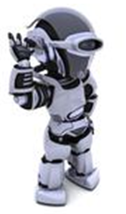
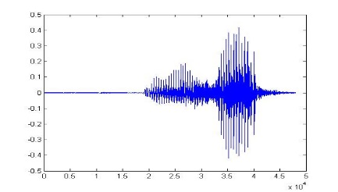
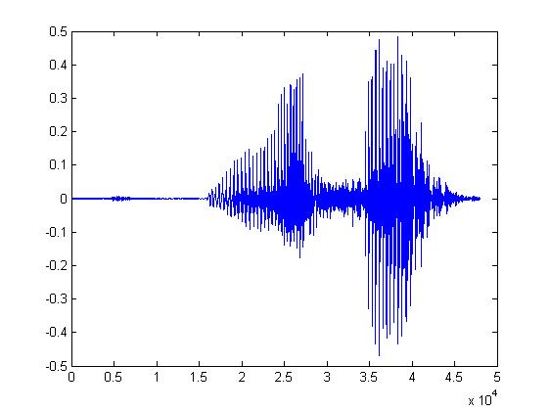
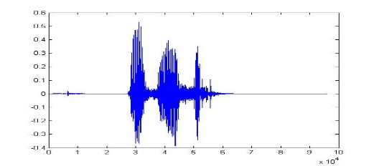
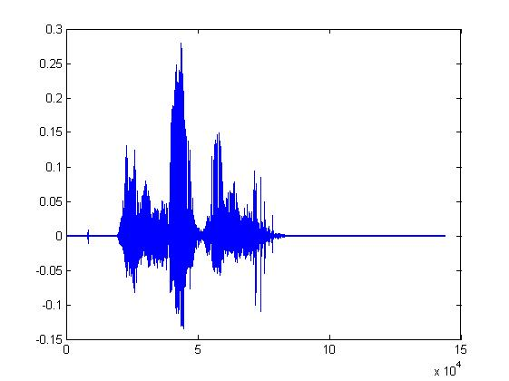
What is Machine Learning?
Learning ......
“Hi”
“How are you”
You said “Hello”
“Good bye”
You write the program for learning.
A large amount of audio data
Notes:
1、Introduction of this course
01_introduction.pptx
参考书
“Machine Learning” (ML) 和 “Machine Learning and having it Deep and Structured” (MLDS) 有何不同？
Speech Recognition 语音识别
Image Recognition 图像识别
Playing Go 下围棋
Dialogue System 对话系统
Goodness of function f 函数优度 f
Regression 回归
Classification 分类
Binary Classification 二元分类
Multi-class Classification 多类分类
Spam filtering 垃圾邮件过滤
Document Classification 文档分类
Linear Model 线性模型
Non-linear Model
Deep Learning 深度学习
Convolutional Neural Network (CNN) 卷积神经网络（CNN）
SVM, decision tree, K-NN … SVM、决策树、K-NN……
Supervised Learning 监督学习
Semi-supervised Learning 半监督学习
Transfer Learning 迁移学习
Data not related to the task considered (can be either labeled or unlabeled) 与考虑的任务无关的数据（可以标记或不标记）
Unsupervised Learning 无监督学习
Machine Reading: Machine learns the meaning of words from reading a lot of documents without supervision 机器阅读：机器无需监督，通过阅读大量文档来学习单词的含义
Structured Learning 结构化学习
Beyond Classification 超越分类
Speech Recognition 语音识别
Machine Translation 机器翻译
Reinforcement Learning 强化学习
Learning from critics 向批评家学习
scenario 设想

Slide 7
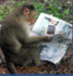

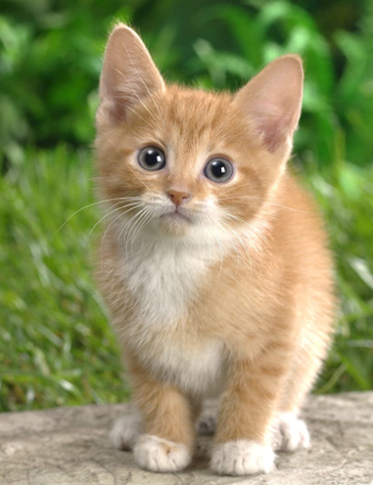

What is Machine Learning?
Learning ......
“monkey”
“cat”
This is “cat”
“dog”
You write the program for learning.
A large amount of images
Notes:
1、Introduction of this course
01_introduction.pptx
参考书
“Machine Learning” (ML) 和 “Machine Learning and having it Deep and Structured” (MLDS) 有何不同？
Speech Recognition 语音识别
Image Recognition 图像识别
Playing Go 下围棋
Dialogue System 对话系统
Goodness of function f 函数优度 f
Regression 回归
Classification 分类
Binary Classification 二元分类
Multi-class Classification 多类分类
Spam filtering 垃圾邮件过滤
Document Classification 文档分类
Linear Model 线性模型
Non-linear Model
Deep Learning 深度学习
Convolutional Neural Network (CNN) 卷积神经网络（CNN）
SVM, decision tree, K-NN … SVM、决策树、K-NN……
Supervised Learning 监督学习
Semi-supervised Learning 半监督学习
Transfer Learning 迁移学习
Data not related to the task considered (can be either labeled or unlabeled) 与考虑的任务无关的数据（可以标记或不标记）
Unsupervised Learning 无监督学习
Machine Reading: Machine learns the meaning of words from reading a lot of documents without supervision 机器阅读：机器无需监督，通过阅读大量文档来学习单词的含义
Structured Learning 结构化学习
Beyond Classification 超越分类
Speech Recognition 语音识别
Machine Translation 机器翻译
Reinforcement Learning 强化学习
Learning from critics 向批评家学习
scenario 设想

Slide 8

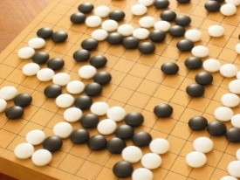
Machine Learning ≈ Looking for a Function
Speech Recognition
Image Recognition
Playing Go
Dialogue System
“How are you”
“Cat”
“5-5”
(next move)
“Hi”
“Hello”
(what the user said)
(system response)
Notes:
1、Introduction of this course
01_introduction.pptx
参考书
“Machine Learning” (ML) 和 “Machine Learning and having it Deep and Structured” (MLDS) 有何不同？
Speech Recognition 语音识别
Image Recognition 图像识别
Playing Go 下围棋
Dialogue System 对话系统
Goodness of function f 函数优度 f
Regression 回归
Classification 分类
Binary Classification 二元分类
Multi-class Classification 多类分类
Spam filtering 垃圾邮件过滤
Document Classification 文档分类
Linear Model 线性模型
Non-linear Model
Deep Learning 深度学习
Convolutional Neural Network (CNN) 卷积神经网络（CNN）
SVM, decision tree, K-NN … SVM、决策树、K-NN……
Supervised Learning 监督学习
Semi-supervised Learning 半监督学习
Transfer Learning 迁移学习
Data not related to the task considered (can be either labeled or unlabeled) 与考虑的任务无关的数据（可以标记或不标记）
Unsupervised Learning 无监督学习
Machine Reading: Machine learns the meaning of words from reading a lot of documents without supervision 机器阅读：机器无需监督，通过阅读大量文档来学习单词的含义
Structured Learning 结构化学习
Beyond Classification 超越分类
Speech Recognition 语音识别
Machine Translation 机器翻译
Reinforcement Learning 强化学习
Learning from critics 向批评家学习
scenario 设想

Slide 9
Framework
Image Recognition:
“cat”
A set of function
Model
“cat”
“money”
“dog”
“snake”
Notes:
1、Introduction of this course
01_introduction.pptx
参考书
“Machine Learning” (ML) 和 “Machine Learning and having it Deep and Structured” (MLDS) 有何不同？
Speech Recognition 语音识别
Image Recognition 图像识别
Playing Go 下围棋
Dialogue System 对话系统
Goodness of function f 函数优度 f
Regression 回归
Classification 分类
Binary Classification 二元分类
Multi-class Classification 多类分类
Spam filtering 垃圾邮件过滤
Document Classification 文档分类
Linear Model 线性模型
Non-linear Model
Deep Learning 深度学习
Convolutional Neural Network (CNN) 卷积神经网络（CNN）
SVM, decision tree, K-NN … SVM、决策树、K-NN……
Supervised Learning 监督学习
Semi-supervised Learning 半监督学习
Transfer Learning 迁移学习
Data not related to the task considered (can be either labeled or unlabeled) 与考虑的任务无关的数据（可以标记或不标记）
Unsupervised Learning 无监督学习
Machine Reading: Machine learns the meaning of words from reading a lot of documents without supervision 机器阅读：机器无需监督，通过阅读大量文档来学习单词的含义
Structured Learning 结构化学习
Beyond Classification 超越分类
Speech Recognition 语音识别
Machine Translation 机器翻译
Reinforcement Learning 强化学习
Learning from critics 向批评家学习
scenario 设想

Slide 10
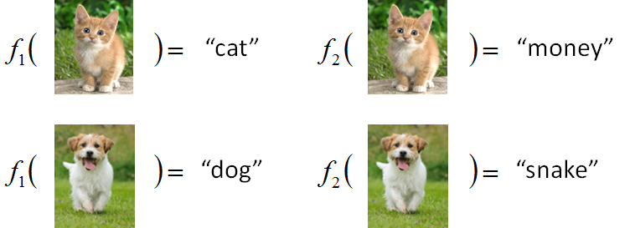
Framework
Image Recognition:
“cat”
A set of function
Model
Better!
Goodness of function f
Training
Data
function input:
function output:
“monkey”
“cat”
“dog”
Notes:
1、Introduction of this course
01_introduction.pptx
参考书
“Machine Learning” (ML) 和 “Machine Learning and having it Deep and Structured” (MLDS) 有何不同？
Speech Recognition 语音识别
Image Recognition 图像识别
Playing Go 下围棋
Dialogue System 对话系统
Goodness of function f 函数优度 f
Regression 回归
Classification 分类
Binary Classification 二元分类
Multi-class Classification 多类分类
Spam filtering 垃圾邮件过滤
Document Classification 文档分类
Linear Model 线性模型
Non-linear Model
Deep Learning 深度学习
Convolutional Neural Network (CNN) 卷积神经网络（CNN）
SVM, decision tree, K-NN … SVM、决策树、K-NN……
Supervised Learning 监督学习
Semi-supervised Learning 半监督学习
Transfer Learning 迁移学习
Data not related to the task considered (can be either labeled or unlabeled) 与考虑的任务无关的数据（可以标记或不标记）
Unsupervised Learning 无监督学习
Machine Reading: Machine learns the meaning of words from reading a lot of documents without supervision 机器阅读：机器无需监督，通过阅读大量文档来学习单词的含义
Structured Learning 结构化学习
Beyond Classification 超越分类
Speech Recognition 语音识别
Machine Translation 机器翻译
Reinforcement Learning 强化学习
Learning from critics 向批评家学习
scenario 设想

Slide 11
Framework
Image Recognition:
“cat”
A set of function
Model
Training
Testing
“cat”
Step 1
Goodness of function f
Pick the “Best” Function
Using
Step 2
Step 3
Training
Data
“monkey”
“cat”
“dog”
Notes:
1、Introduction of this course
01_introduction.pptx
参考书
“Machine Learning” (ML) 和 “Machine Learning and having it Deep and Structured” (MLDS) 有何不同？
Speech Recognition 语音识别
Image Recognition 图像识别
Playing Go 下围棋
Dialogue System 对话系统
Goodness of function f 函数优度 f
Regression 回归
Classification 分类
Binary Classification 二元分类
Multi-class Classification 多类分类
Spam filtering 垃圾邮件过滤
Document Classification 文档分类
Linear Model 线性模型
Non-linear Model
Deep Learning 深度学习
Convolutional Neural Network (CNN) 卷积神经网络（CNN）
SVM, decision tree, K-NN … SVM、决策树、K-NN……
Supervised Learning 监督学习
Semi-supervised Learning 半监督学习
Transfer Learning 迁移学习
Data not related to the task considered (can be either labeled or unlabeled) 与考虑的任务无关的数据（可以标记或不标记）
Unsupervised Learning 无监督学习
Machine Reading: Machine learns the meaning of words from reading a lot of documents without supervision 机器阅读：机器无需监督，通过阅读大量文档来学习单词的含义
Structured Learning 结构化学习
Beyond Classification 超越分类
Speech Recognition 语音识别
Machine Translation 机器翻译
Reinforcement Learning 强化学习
Learning from critics 向批评家学习
scenario 设想

Slide 12
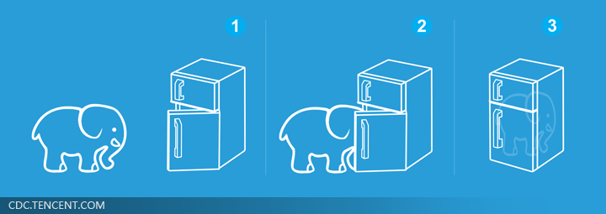
Machine Learning is so simple ……
Step 1: define a set of function
Step 2: goodness of function
Step 3: pick the best function
就好像把大象放進冰箱 ……
Notes:
1、Introduction of this course
01_introduction.pptx
参考书
“Machine Learning” (ML) 和 “Machine Learning and having it Deep and Structured” (MLDS) 有何不同？
Speech Recognition 语音识别
Image Recognition 图像识别
Playing Go 下围棋
Dialogue System 对话系统
Goodness of function f 函数优度 f
Regression 回归
Classification 分类
Binary Classification 二元分类
Multi-class Classification 多类分类
Spam filtering 垃圾邮件过滤
Document Classification 文档分类
Linear Model 线性模型
Non-linear Model
Deep Learning 深度学习
Convolutional Neural Network (CNN) 卷积神经网络（CNN）
SVM, decision tree, K-NN … SVM、决策树、K-NN……
Supervised Learning 监督学习
Semi-supervised Learning 半监督学习
Transfer Learning 迁移学习
Data not related to the task considered (can be either labeled or unlabeled) 与考虑的任务无关的数据（可以标记或不标记）
Unsupervised Learning 无监督学习
Machine Reading: Machine learns the meaning of words from reading a lot of documents without supervision 机器阅读：机器无需监督，通过阅读大量文档来学习单词的含义
Structured Learning 结构化学习
Beyond Classification 超越分类
Speech Recognition 语音识别
Machine Translation 机器翻译
Reinforcement Learning 强化学习
Learning from critics 向批评家学习
scenario 设想

Slide 13
Learning Map
Notes:
1、Introduction of this course
01_introduction.pptx
参考书
“Machine Learning” (ML) 和 “Machine Learning and having it Deep and Structured” (MLDS) 有何不同？
Speech Recognition 语音识别
Image Recognition 图像识别
Playing Go 下围棋
Dialogue System 对话系统
Goodness of function f 函数优度 f
Regression 回归
Classification 分类
Binary Classification 二元分类
Multi-class Classification 多类分类
Spam filtering 垃圾邮件过滤
Document Classification 文档分类
Linear Model 线性模型
Non-linear Model
Deep Learning 深度学习
Convolutional Neural Network (CNN) 卷积神经网络（CNN）
SVM, decision tree, K-NN … SVM、决策树、K-NN……
Supervised Learning 监督学习
Semi-supervised Learning 半监督学习
Transfer Learning 迁移学习
Data not related to the task considered (can be either labeled or unlabeled) 与考虑的任务无关的数据（可以标记或不标记）
Unsupervised Learning 无监督学习
Machine Reading: Machine learns the meaning of words from reading a lot of documents without supervision 机器阅读：机器无需监督，通过阅读大量文档来学习单词的含义
Structured Learning 结构化学习
Beyond Classification 超越分类
Speech Recognition 语音识别
Machine Translation 机器翻译
Reinforcement Learning 强化学习
Learning from critics 向批评家学习
scenario 设想

Slide 14
Learning Map
scenario
task
method
Learning Theory
Semi-supervised Learning
Transfer Learning
Regression
Unsupervised Learning
Reinforcement Learning
Linear Model
Deep Learning
SVM, decision tree, K-NN …
Structured Learning
Non-linear Model
Classification
Supervised Learning
Notes:
1、Introduction of this course
01_introduction.pptx
参考书
“Machine Learning” (ML) 和 “Machine Learning and having it Deep and Structured” (MLDS) 有何不同？
Speech Recognition 语音识别
Image Recognition 图像识别
Playing Go 下围棋
Dialogue System 对话系统
Goodness of function f 函数优度 f
Learning Theory 学习理论
scenario 设想
Supervised Learning 监督学习
Semi-supervised Learning 半监督学习
Transfer Learning 迁移学习
Unsupervised Learning 无监督学习
Reinforcement Learning 强化学习
task
Regression 回归
Classification 分类
Structured Learning 结构化学习
method
Linear Model 线性模型
Non-linear Model
Deep Learning 深度学习
SVM, decision tree, K-NN … SVM、决策树、K-NN……
Binary Classification 二元分类
Multi-class Classification 多类分类
Spam filtering 垃圾邮件过滤
Document Classification 文档分类
Convolutional Neural Network (CNN) 卷积神经网络（CNN）
Data not related to the task considered (can be either labeled or unlabeled) 与考虑的任务无关的数据（可以标记或不标记）
Machine Reading: Machine learns the meaning of words from reading a lot of documents without supervision 机器阅读：机器无需监督，通过阅读大量文档来学习单词的含义
Beyond Classification 超越分类
Speech Recognition 语音识别
Machine Translation 机器翻译
Learning from critics 向批评家学习

Slide 15
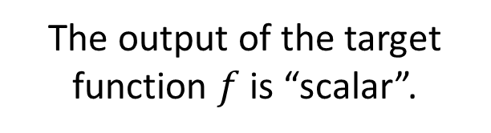
Learning Map
The output of the target function $f$ is “scalar”.
Regression
預測
PM2.5
今天上午 PM2.5
f
昨天上午PM2.5
明天上午PM2.5
…….
(scalar)
Training Data:
Input:
Output:
9/01 上午 PM2.5 = 63
9/02 上午 PM2.5 = 65
9/03 上午 PM2.5 = 100
Input:
Output:
9/12 上午 PM2.5 = 30
9/13 上午 PM2.5 = 25
9/14 上午 PM2.5 = 20
Notes:
1、Introduction of this course
01_introduction.pptx
参考书
“Machine Learning” (ML) 和 “Machine Learning and having it Deep and Structured” (MLDS) 有何不同？
Speech Recognition 语音识别
Image Recognition 图像识别
Playing Go 下围棋
Dialogue System 对话系统
Goodness of function f 函数优度 f
Learning Theory 学习理论
scenario 设想
Supervised Learning 监督学习
Semi-supervised Learning 半监督学习
Transfer Learning 迁移学习
Unsupervised Learning 无监督学习
Reinforcement Learning 强化学习
task
Regression 回归
Classification 分类
Structured Learning 结构化学习
method
Linear Model 线性模型
Non-linear Model
Deep Learning 深度学习
SVM, decision tree, K-NN … SVM、决策树、K-NN……
Regression
The output of the target function $f$ is “scalar”.
Binary Classification 二元分类
Multi-class Classification 多类分类
Spam filtering 垃圾邮件过滤
Document Classification 文档分类
Convolutional Neural Network (CNN) 卷积神经网络（CNN）
Data not related to the task considered (can be either labeled or unlabeled) 与考虑的任务无关的数据（可以标记或不标记）
Machine Reading: Machine learns the meaning of words from reading a lot of documents without supervision 机器阅读：机器无需监督，通过阅读大量文档来学习单词的含义
Beyond Classification 超越分类
Speech Recognition 语音识别
Machine Translation 机器翻译
Learning from critics 向批评家学习

Slide 16
Learning Map
Regression
Classification
Notes:
1、Introduction of this course
01_introduction.pptx
参考书
“Machine Learning” (ML) 和 “Machine Learning and having it Deep and Structured” (MLDS) 有何不同？
Speech Recognition 语音识别
Image Recognition 图像识别
Playing Go 下围棋
Dialogue System 对话系统
Goodness of function f 函数优度 f
Learning Theory 学习理论
scenario 设想
Supervised Learning 监督学习
Semi-supervised Learning 半监督学习
Transfer Learning 迁移学习
Unsupervised Learning 无监督学习
Reinforcement Learning 强化学习
task
Regression 回归
Classification 分类
Structured Learning 结构化学习
method
Linear Model 线性模型
Non-linear Model
Deep Learning 深度学习
SVM, decision tree, K-NN … SVM、决策树、K-NN……
Regression
The output of the target function $f$ is “scalar”.
Binary Classification 二元分类
Multi-class Classification 多类分类
Spam filtering 垃圾邮件过滤
Document Classification 文档分类
Convolutional Neural Network (CNN) 卷积神经网络（CNN）
Data not related to the task considered (can be either labeled or unlabeled) 与考虑的任务无关的数据（可以标记或不标记）
Machine Reading: Machine learns the meaning of words from reading a lot of documents without supervision 机器阅读：机器无需监督，通过阅读大量文档来学习单词的含义
Beyond Classification 超越分类
Speech Recognition 语音识别
Machine Translation 机器翻译
Learning from critics 向批评家学习

Slide 17
Classification
Binary Classification
Multi-class Classification
Yes or No
Class 1, Class 2, … Class N
Function f
Function f
Input
Input
Notes:
1、Introduction of this course
01_introduction.pptx
参考书
“Machine Learning” (ML) 和 “Machine Learning and having it Deep and Structured” (MLDS) 有何不同？
Speech Recognition 语音识别
Image Recognition 图像识别
Playing Go 下围棋
Dialogue System 对话系统
Goodness of function f 函数优度 f
Learning Theory 学习理论
scenario 设想
Supervised Learning 监督学习
Semi-supervised Learning 半监督学习
Transfer Learning 迁移学习
Unsupervised Learning 无监督学习
Reinforcement Learning 强化学习
task
Regression 回归
Classification 分类
Structured Learning 结构化学习
method
Linear Model 线性模型
Non-linear Model
Deep Learning 深度学习
SVM, decision tree, K-NN … SVM、决策树、K-NN……
Regression
The output of the target function $f$ is “scalar”.
Binary Classification 二元分类
Multi-class Classification 多类分类
Spam filtering 垃圾邮件过滤
Document Classification 文档分类
Convolutional Neural Network (CNN) 卷积神经网络（CNN）
Data not related to the task considered (can be either labeled or unlabeled) 与考虑的任务无关的数据（可以标记或不标记）
Machine Reading: Machine learns the meaning of words from reading a lot of documents without supervision 机器阅读：机器无需监督，通过阅读大量文档来学习单词的含义
Beyond Classification 超越分类
Speech Recognition 语音识别
Machine Translation 机器翻译
Learning from critics 向批评家学习

Slide 18


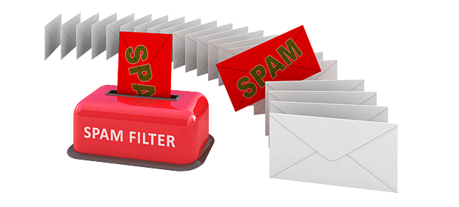
Binary Classification
Spam
filtering
Function
Yes/No
Yes
Training
Data
No
(http://spam-filter-review.toptenreviews.com/)
Notes:
1、Introduction of this course
01_introduction.pptx
参考书
“Machine Learning” (ML) 和 “Machine Learning and having it Deep and Structured” (MLDS) 有何不同？
Speech Recognition 语音识别
Image Recognition 图像识别
Playing Go 下围棋
Dialogue System 对话系统
Goodness of function f 函数优度 f
Learning Theory 学习理论
scenario 设想
Supervised Learning 监督学习
Semi-supervised Learning 半监督学习
Transfer Learning 迁移学习
Unsupervised Learning 无监督学习
Reinforcement Learning 强化学习
task
Regression 回归
Classification 分类
Structured Learning 结构化学习
method
Linear Model 线性模型
Non-linear Model
Deep Learning 深度学习
SVM, decision tree, K-NN … SVM、决策树、K-NN……
Regression
The output of the target function $f$ is “scalar”.
Binary Classification 二元分类
Multi-class Classification 多类分类
Spam filtering 垃圾邮件过滤
Document Classification 文档分类
Convolutional Neural Network (CNN) 卷积神经网络（CNN）
Data not related to the task considered (can be either labeled or unlabeled) 与考虑的任务无关的数据（可以标记或不标记）
Machine Reading: Machine learns the meaning of words from reading a lot of documents without supervision 机器阅读：机器无需监督，通过阅读大量文档来学习单词的含义
Beyond Classification 超越分类
Speech Recognition 语音识别
Machine Translation 机器翻译
Learning from critics 向批评家学习

Slide 19



Multi-class Classification
政治
Document
Classification
Function
經濟
體育
Training Data
體育
政治
財經
http://top-breaking-news.com/
Notes:
1、Introduction of this course
01_introduction.pptx
参考书
“Machine Learning” (ML) 和 “Machine Learning and having it Deep and Structured” (MLDS) 有何不同？
Speech Recognition 语音识别
Image Recognition 图像识别
Playing Go 下围棋
Dialogue System 对话系统
Goodness of function f 函数优度 f
Learning Theory 学习理论
scenario 设想
Supervised Learning 监督学习
Semi-supervised Learning 半监督学习
Transfer Learning 迁移学习
Unsupervised Learning 无监督学习
Reinforcement Learning 强化学习
task
Regression 回归
Classification 分类
Structured Learning 结构化学习
method
Linear Model 线性模型
Non-linear Model
Deep Learning 深度学习
SVM, decision tree, K-NN … SVM、决策树、K-NN……
Regression
The output of the target function $f$ is “scalar”.
Binary Classification 二元分类
Multi-class Classification 多类分类
Spam filtering 垃圾邮件过滤
Document Classification 文档分类
Convolutional Neural Network (CNN) 卷积神经网络（CNN）
Data not related to the task considered (can be either labeled or unlabeled) 与考虑的任务无关的数据（可以标记或不标记）
Machine Reading: Machine learns the meaning of words from reading a lot of documents without supervision 机器阅读：机器无需监督，通过阅读大量文档来学习单词的含义
Beyond Classification 超越分类
Speech Recognition 语音识别
Machine Translation 机器翻译
Learning from critics 向批评家学习

Slide 20
Learning Map
Regression
Linear Model
Deep Learning
Non-linear Model
Classification
Notes:
1、Introduction of this course
01_introduction.pptx
参考书
“Machine Learning” (ML) 和 “Machine Learning and having it Deep and Structured” (MLDS) 有何不同？
Speech Recognition 语音识别
Image Recognition 图像识别
Playing Go 下围棋
Dialogue System 对话系统
Goodness of function f 函数优度 f
Learning Theory 学习理论
scenario 设想
Supervised Learning 监督学习
Semi-supervised Learning 半监督学习
Transfer Learning 迁移学习
Unsupervised Learning 无监督学习
Reinforcement Learning 强化学习
task
Regression 回归
Classification 分类
Structured Learning 结构化学习
method
Linear Model 线性模型
Non-linear Model
Deep Learning 深度学习
SVM, decision tree, K-NN … SVM、决策树、K-NN……
Regression
The output of the target function $f$ is “scalar”.
Binary Classification 二元分类
Multi-class Classification 多类分类
Spam filtering 垃圾邮件过滤
Document Classification 文档分类
Convolutional Neural Network (CNN) 卷积神经网络（CNN）
Data not related to the task considered (can be either labeled or unlabeled) 与考虑的任务无关的数据（可以标记或不标记）
Machine Reading: Machine learns the meaning of words from reading a lot of documents without supervision 机器阅读：机器无需监督，通过阅读大量文档来学习单词的含义
Beyond Classification 超越分类
Speech Recognition 语音识别
Machine Translation 机器翻译
Learning from critics 向批评家学习

Slide 21
Classification - Deep Learning
Image Recognition
Training Data
Hierarchical Structure
“monkey”
“monkey”
Function
“cat”
“cat”
“dog”
Each possible object is a class
“dog”
Notes:
1、Introduction of this course
01_introduction.pptx
参考书
“Machine Learning” (ML) 和 “Machine Learning and having it Deep and Structured” (MLDS) 有何不同？
Speech Recognition 语音识别
Image Recognition 图像识别
Playing Go 下围棋
Dialogue System 对话系统
Goodness of function f 函数优度 f
Learning Theory 学习理论
scenario 设想
Supervised Learning 监督学习
Semi-supervised Learning 半监督学习
Transfer Learning 迁移学习
Unsupervised Learning 无监督学习
Reinforcement Learning 强化学习
task
Regression 回归
Classification 分类
Structured Learning 结构化学习
method
Linear Model 线性模型
Non-linear Model
Deep Learning 深度学习
SVM, decision tree, K-NN … SVM、决策树、K-NN……
Regression
The output of the target function $f$ is “scalar”.
Binary Classification 二元分类
Multi-class Classification 多类分类
Spam filtering 垃圾邮件过滤
Document Classification 文档分类
Hierarchical Structure 层次结构
Convolutional Neural Network (CNN) 卷积神经网络（CNN）
Data not related to the task considered (can be either labeled or unlabeled) 与考虑的任务无关的数据（可以标记或不标记）
Machine Reading: Machine learns the meaning of words from reading a lot of documents without supervision 机器阅读：机器无需监督，通过阅读大量文档来学习单词的含义
Beyond Classification 超越分类
Speech Recognition 语音识别
Machine Translation 机器翻译
Learning from critics 向批评家学习

Slide 22
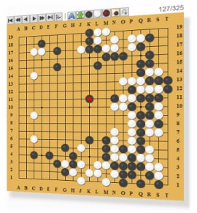
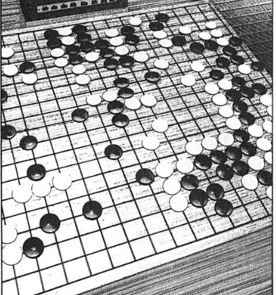
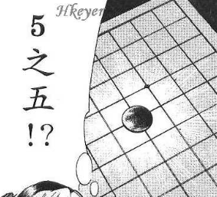
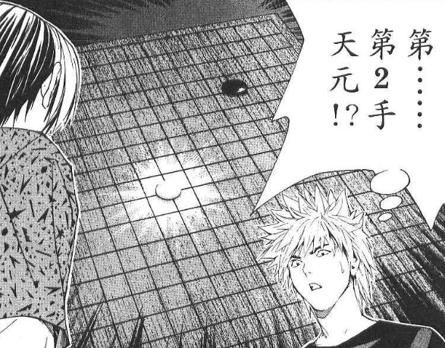
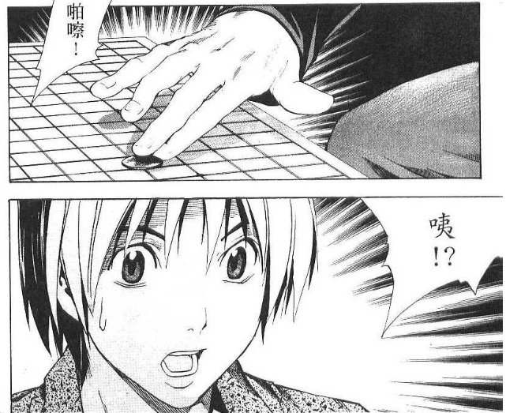
Classification - Deep Learning
Next move
Function
Playing GO
Each position is a class
(19 x 19 classes)
Training Data
進藤光 v.s. 社清春
黑: 5之五
白: 天元
黑: 五之5
一堆棋譜
Notes:
1、Introduction of this course
01_introduction.pptx
参考书
“Machine Learning” (ML) 和 “Machine Learning and having it Deep and Structured” (MLDS) 有何不同？
Speech Recognition 语音识别
Image Recognition 图像识别
Playing Go 下围棋
Dialogue System 对话系统
Goodness of function f 函数优度 f
Learning Theory 学习理论
scenario 设想
Supervised Learning 监督学习
Semi-supervised Learning 半监督学习
Transfer Learning 迁移学习
Unsupervised Learning 无监督学习
Reinforcement Learning 强化学习
task
Regression 回归
Classification 分类
Structured Learning 结构化学习
method
Linear Model 线性模型
Non-linear Model
Deep Learning 深度学习
SVM, decision tree, K-NN … SVM、决策树、K-NN……
Regression
The output of the target function $f$ is “scalar”.
Binary Classification 二元分类
Multi-class Classification 多类分类
Spam filtering 垃圾邮件过滤
Document Classification 文档分类
Hierarchical Structure 层次结构
需要注意下围棋的训练数据的组织形式
Convolutional Neural Network (CNN) 卷积神经网络（CNN）
Data not related to the task considered (can be either labeled or unlabeled) 与考虑的任务无关的数据（可以标记或不标记）
Machine Reading: Machine learns the meaning of words from reading a lot of documents without supervision 机器阅读：机器无需监督，通过阅读大量文档来学习单词的含义
Beyond Classification 超越分类
Speech Recognition 语音识别
Machine Translation 机器翻译
Learning from critics 向批评家学习

Slide 23
Classification - Deep Learning
Next move
Function
Playing GO
Each position is a class
(19 x 19 classes)
Training Data
進藤光 v.s. 社清春
黑: 5之五
白: 天元
黑: 五之5
Input:
黑: 5之五
Output:
天元
Input:
黑: 5之五、白: 天元
Output:
五之5
一堆棋譜
Notes:
1、Introduction of this course
01_introduction.pptx
参考书
“Machine Learning” (ML) 和 “Machine Learning and having it Deep and Structured” (MLDS) 有何不同？
Speech Recognition 语音识别
Image Recognition 图像识别
Playing Go 下围棋
Dialogue System 对话系统
Goodness of function f 函数优度 f
Learning Theory 学习理论
scenario 设想
Supervised Learning 监督学习
Semi-supervised Learning 半监督学习
Transfer Learning 迁移学习
Unsupervised Learning 无监督学习
Reinforcement Learning 强化学习
task
Regression 回归
Classification 分类
Structured Learning 结构化学习
method
Linear Model 线性模型
Non-linear Model
Deep Learning 深度学习
SVM, decision tree, K-NN … SVM、决策树、K-NN……
Regression
The output of the target function $f$ is “scalar”.
Binary Classification 二元分类
Multi-class Classification 多类分类
Spam filtering 垃圾邮件过滤
Document Classification 文档分类
Hierarchical Structure 层次结构
需要注意下围棋的训练数据的组织形式
Convolutional Neural Network (CNN) 卷积神经网络（CNN）
Data not related to the task considered (can be either labeled or unlabeled) 与考虑的任务无关的数据（可以标记或不标记）
Machine Reading: Machine learns the meaning of words from reading a lot of documents without supervision 机器阅读：机器无需监督，通过阅读大量文档来学习单词的含义
Beyond Classification 超越分类
Speech Recognition 语音识别
Machine Translation 机器翻译
Learning from critics 向批评家学习

Slide 24
Learning Map
Hard to collect a large amount of labelled data
Semi-supervised Learning
Regression
Linear Model
Training Data:
Deep Learning
SVM, decision tree, K-NN …
Input/output pair of target function
Non-linear Model
Classification
Function output = label
Supervised Learning
Notes:
1、Introduction of this course
01_introduction.pptx
参考书
“Machine Learning” (ML) 和 “Machine Learning and having it Deep and Structured” (MLDS) 有何不同？
Speech Recognition 语音识别
Image Recognition 图像识别
Playing Go 下围棋
Dialogue System 对话系统
Goodness of function f 函数优度 f
Learning Theory 学习理论
scenario 设想
Supervised Learning 监督学习
Semi-supervised Learning 半监督学习
Transfer Learning 迁移学习
Unsupervised Learning 无监督学习
Reinforcement Learning 强化学习
task
Regression 回归
Classification 分类
Structured Learning 结构化学习
method
Linear Model 线性模型
Non-linear Model
Deep Learning 深度学习
SVM, decision tree, K-NN … SVM、决策树、K-NN……
Regression
The output of the target function $f$ is “scalar”.
Binary Classification 二元分类
Multi-class Classification 多类分类
Spam filtering 垃圾邮件过滤
Document Classification 文档分类
Hierarchical Structure 层次结构
需要注意下围棋的训练数据的组织形式
Convolutional Neural Network (CNN) 卷积神经网络（CNN）
Data not related to the task considered (can be either labeled or unlabeled) 与考虑的任务无关的数据（可以标记或不标记）
Machine Reading: Machine learns the meaning of words from reading a lot of documents without supervision 机器阅读：机器无需监督，通过阅读大量文档来学习单词的含义
Beyond Classification 超越分类
Speech Recognition 语音识别
Machine Translation 机器翻译
Learning from critics 向批评家学习

Slide 25
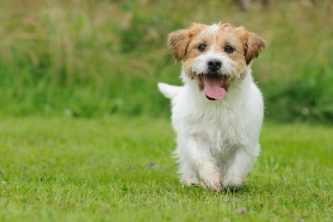

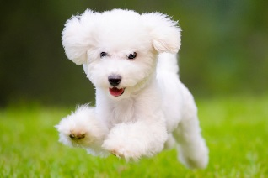
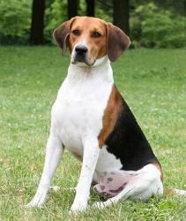
Semi-supervised Learning
For example, recognizing cats and dogs
Labelled data
cat
dog
Unlabeled data
(Images of cats and dogs)
Notes:
1、Introduction of this course
01_introduction.pptx
参考书
“Machine Learning” (ML) 和 “Machine Learning and having it Deep and Structured” (MLDS) 有何不同？
Speech Recognition 语音识别
Image Recognition 图像识别
Playing Go 下围棋
Dialogue System 对话系统
Goodness of function f 函数优度 f
Learning Theory 学习理论
scenario 设想
Supervised Learning 监督学习
Semi-supervised Learning 半监督学习
Transfer Learning 迁移学习
Unsupervised Learning 无监督学习
Reinforcement Learning 强化学习
task
Regression 回归
Classification 分类
Structured Learning 结构化学习
method
Linear Model 线性模型
Non-linear Model
Deep Learning 深度学习
SVM, decision tree, K-NN … SVM、决策树、K-NN……
Regression
The output of the target function $f$ is “scalar”.
Binary Classification 二元分类
Multi-class Classification 多类分类
Spam filtering 垃圾邮件过滤
Document Classification 文档分类
Hierarchical Structure 层次结构
需要注意下围棋的训练数据的组织形式
半监督学习和迁移学习的区别是同样是猫狗分类的任务，
半监督学习使用的全部是猫和狗的图片，只不过有一部分图片没有标签，
迁移学习除了使用猫和狗的图片，还使用了其他图片，这些图片和猫狗无关
Convolutional Neural Network (CNN) 卷积神经网络（CNN）
Data not related to the task considered (can be either labeled or unlabeled) 与考虑的任务无关的数据（可以标记或不标记）
Machine Reading: Machine learns the meaning of words from reading a lot of documents without supervision 机器阅读：机器无需监督，通过阅读大量文档来学习单词的含义
Beyond Classification 超越分类
Speech Recognition 语音识别
Machine Translation 机器翻译
Learning from critics 向批评家学习

Slide 26
Learning Map
Semi-supervised Learning
Transfer Learning
Regression
Linear Model
Deep Learning
SVM, decision tree, K-NN …
Structured Learning
Non-linear Model
Classification
Supervised Learning

Slide 27
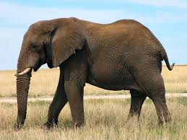
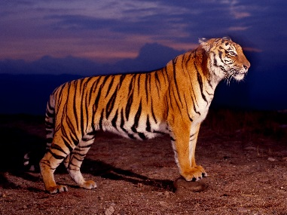


Transfer Learning
For example, recognizing cats and dogs
Labelled data
cat
dog
elephant
Haruhi
Data not related to the task considered (can be either labeled or unlabeled)
Notes:
1、Introduction of this course
01_introduction.pptx
参考书
“Machine Learning” (ML) 和 “Machine Learning and having it Deep and Structured” (MLDS) 有何不同？
Speech Recognition 语音识别
Image Recognition 图像识别
Playing Go 下围棋
Dialogue System 对话系统
Goodness of function f 函数优度 f
Learning Theory 学习理论
scenario 设想
Supervised Learning 监督学习
Semi-supervised Learning 半监督学习
Transfer Learning 迁移学习
Unsupervised Learning 无监督学习
Reinforcement Learning 强化学习
task
Regression 回归
Classification 分类
Structured Learning 结构化学习
method
Linear Model 线性模型
Non-linear Model
Deep Learning 深度学习
SVM, decision tree, K-NN … SVM、决策树、K-NN……
Regression
The output of the target function $f$ is “scalar”.
Binary Classification 二元分类
Multi-class Classification 多类分类
Spam filtering 垃圾邮件过滤
Document Classification 文档分类
Hierarchical Structure 层次结构
需要注意下围棋的训练数据的组织形式
半监督学习和迁移学习的区别是同样是猫狗分类的任务，
半监督学习使用的全部是猫和狗的图片，只不过有一部分图片没有标签，
迁移学习除了使用猫和狗的图片，还使用了其他图片，这些图片和猫狗无关
Data not related to the task considered (can be either labeled or unlabeled) 与考虑的任务无关的数据（可以标记或不标记）
Convolutional Neural Network (CNN) 卷积神经网络（CNN）
Machine Reading: Machine learns the meaning of words from reading a lot of documents without supervision 机器阅读：机器无需监督，通过阅读大量文档来学习单词的含义
Beyond Classification 超越分类
Speech Recognition 语音识别
Machine Translation 机器翻译
Learning from critics 向批评家学习

Slide 28
Learning Map
Semi-supervised Learning
Transfer Learning
Regression
Unsupervised Learning
Linear Model
Deep Learning
SVM, decision tree, K-NN …
Structured Learning
Non-linear Model
Classification
Supervised Learning
Notes:
1、Introduction of this course
01_introduction.pptx
参考书
“Machine Learning” (ML) 和 “Machine Learning and having it Deep and Structured” (MLDS) 有何不同？
Speech Recognition 语音识别
Image Recognition 图像识别
Playing Go 下围棋
Dialogue System 对话系统
Goodness of function f 函数优度 f
Learning Theory 学习理论
scenario 设想
Supervised Learning 监督学习
Semi-supervised Learning 半监督学习
Transfer Learning 迁移学习
Unsupervised Learning 无监督学习
Reinforcement Learning 强化学习
task
Regression 回归
Classification 分类
Structured Learning 结构化学习
method
Linear Model 线性模型
Non-linear Model
Deep Learning 深度学习
SVM, decision tree, K-NN … SVM、决策树、K-NN……
Regression
The output of the target function $f$ is “scalar”.
Binary Classification 二元分类
Multi-class Classification 多类分类
Spam filtering 垃圾邮件过滤
Document Classification 文档分类
Hierarchical Structure 层次结构
需要注意下围棋的训练数据的组织形式
半监督学习和迁移学习的区别是同样是猫狗分类的任务，
半监督学习使用的全部是猫和狗的图片，只不过有一部分图片没有标签，
迁移学习除了使用猫和狗的图片，还使用了其他图片，这些图片和猫狗无关
Data not related to the task considered (can be either labeled or unlabeled) 与考虑的任务无关的数据（可以标记或不标记）
Convolutional Neural Network (CNN) 卷积神经网络（CNN）
Machine Reading: Machine learns the meaning of words from reading a lot of documents without supervision 机器阅读：机器无需监督，通过阅读大量文档来学习单词的含义
Beyond Classification 超越分类
Speech Recognition 语音识别
Machine Translation 机器翻译
Learning from critics 向批评家学习

Slide 29


Unsupervised Learning
Machine Reading: Machine learns the meaning of words from reading a lot of documents
http://top-breaking-news.com/
Notes:
1、Introduction of this course
01_introduction.pptx
参考书
“Machine Learning” (ML) 和 “Machine Learning and having it Deep and Structured” (MLDS) 有何不同？
Speech Recognition 语音识别
Image Recognition 图像识别
Playing Go 下围棋
Dialogue System 对话系统
Goodness of function f 函数优度 f
Learning Theory 学习理论
scenario 设想
Supervised Learning 监督学习
Semi-supervised Learning 半监督学习
Transfer Learning 迁移学习
Unsupervised Learning 无监督学习
Reinforcement Learning 强化学习
task
Regression 回归
Classification 分类
Structured Learning 结构化学习
method
Linear Model 线性模型
Non-linear Model
Deep Learning 深度学习
SVM, decision tree, K-NN … SVM、决策树、K-NN……
Regression
The output of the target function $f$ is “scalar”.
Binary Classification 二元分类
Multi-class Classification 多类分类
Spam filtering 垃圾邮件过滤
Document Classification 文档分类
Hierarchical Structure 层次结构
需要注意下围棋的训练数据的组织形式
半监督学习和迁移学习的区别是同样是猫狗分类的任务，
半监督学习使用的全部是猫和狗的图片，只不过有一部分图片没有标签，
迁移学习除了使用猫和狗的图片，还使用了其他图片，这些图片和猫狗无关
Data not related to the task considered (can be either labeled or unlabeled) 与考虑的任务无关的数据（可以标记或不标记）
Machine Reading: Machine learns the meaning of words from reading a lot of documents without supervision 机器阅读：机器无需监督，通过阅读大量文档来学习单词的含义
Convolutional Neural Network (CNN) 卷积神经网络（CNN）
Beyond Classification 超越分类
Speech Recognition 语音识别
Machine Translation 机器翻译
Learning from critics 向批评家学习

Slide 30

Unsupervised Learning
Machine Reading: Machine learns the meaning of words from reading a lot of documents
Apple
Training data is a lot of text
Function
?
https://garavato.files.wordpress.com/2011/11/stacksdocuments.jpg?w=490
Notes:
1、Introduction of this course
01_introduction.pptx
参考书
“Machine Learning” (ML) 和 “Machine Learning and having it Deep and Structured” (MLDS) 有何不同？
Speech Recognition 语音识别
Image Recognition 图像识别
Playing Go 下围棋
Dialogue System 对话系统
Goodness of function f 函数优度 f
Learning Theory 学习理论
scenario 设想
Supervised Learning 监督学习
Semi-supervised Learning 半监督学习
Transfer Learning 迁移学习
Unsupervised Learning 无监督学习
Reinforcement Learning 强化学习
task
Regression 回归
Classification 分类
Structured Learning 结构化学习
method
Linear Model 线性模型
Non-linear Model
Deep Learning 深度学习
SVM, decision tree, K-NN … SVM、决策树、K-NN……
Regression
The output of the target function $f$ is “scalar”.
Binary Classification 二元分类
Multi-class Classification 多类分类
Spam filtering 垃圾邮件过滤
Document Classification 文档分类
Hierarchical Structure 层次结构
需要注意下围棋的训练数据的组织形式
半监督学习和迁移学习的区别是同样是猫狗分类的任务，
半监督学习使用的全部是猫和狗的图片，只不过有一部分图片没有标签，
迁移学习除了使用猫和狗的图片，还使用了其他图片，这些图片和猫狗无关
Data not related to the task considered (can be either labeled or unlabeled) 与考虑的任务无关的数据（可以标记或不标记）
Machine Reading: Machine learns the meaning of words from reading a lot of documents without supervision 机器阅读：机器无需监督，通过阅读大量文档来学习单词的含义
Convolutional Neural Network (CNN) 卷积神经网络（CNN）
Beyond Classification 超越分类
Speech Recognition 语音识别
Machine Translation 机器翻译
Learning from critics 向批评家学习

Slide 31
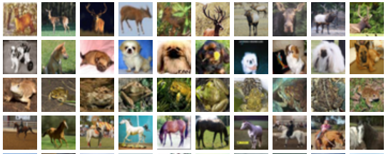

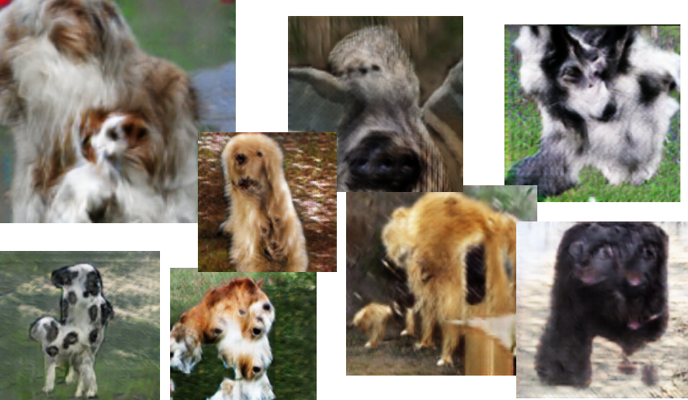
Unsupervised Learning
Draw something!
http://ttic.uchicago.edu/~klivescu/MLSLP2016/ (slides of Ian Goodfellow)
Notes:
1、Introduction of this course
01_introduction.pptx
参考书
“Machine Learning” (ML) 和 “Machine Learning and having it Deep and Structured” (MLDS) 有何不同？
Speech Recognition 语音识别
Image Recognition 图像识别
Playing Go 下围棋
Dialogue System 对话系统
Goodness of function f 函数优度 f
Learning Theory 学习理论
scenario 设想
Supervised Learning 监督学习
Semi-supervised Learning 半监督学习
Transfer Learning 迁移学习
Unsupervised Learning 无监督学习
Reinforcement Learning 强化学习
task
Regression 回归
Classification 分类
Structured Learning 结构化学习
method
Linear Model 线性模型
Non-linear Model
Deep Learning 深度学习
SVM, decision tree, K-NN … SVM、决策树、K-NN……
Regression
The output of the target function $f$ is “scalar”.
Binary Classification 二元分类
Multi-class Classification 多类分类
Spam filtering 垃圾邮件过滤
Document Classification 文档分类
Hierarchical Structure 层次结构
需要注意下围棋的训练数据的组织形式
半监督学习和迁移学习的区别是同样是猫狗分类的任务，
半监督学习使用的全部是猫和狗的图片，只不过有一部分图片没有标签，
迁移学习除了使用猫和狗的图片，还使用了其他图片，这些图片和猫狗无关
Data not related to the task considered (can be either labeled or unlabeled) 与考虑的任务无关的数据（可以标记或不标记）
Machine Reading: Machine learns the meaning of words from reading a lot of documents without supervision 机器阅读：机器无需监督，通过阅读大量文档来学习单词的含义
Convolutional Neural Network (CNN) 卷积神经网络（CNN）
Beyond Classification 超越分类
Speech Recognition 语音识别
Machine Translation 机器翻译
Learning from critics 向批评家学习

Slide 32

Unsupervised Learning
Machine Drawing
?
code
Training data is a lot of images
Function
Notes:
1、Introduction of this course
01_introduction.pptx
参考书
“Machine Learning” (ML) 和 “Machine Learning and having it Deep and Structured” (MLDS) 有何不同？
Speech Recognition 语音识别
Image Recognition 图像识别
Playing Go 下围棋
Dialogue System 对话系统
Goodness of function f 函数优度 f
Learning Theory 学习理论
scenario 设想
Supervised Learning 监督学习
Semi-supervised Learning 半监督学习
Transfer Learning 迁移学习
Unsupervised Learning 无监督学习
Reinforcement Learning 强化学习
task
Regression 回归
Classification 分类
Structured Learning 结构化学习
method
Linear Model 线性模型
Non-linear Model
Deep Learning 深度学习
SVM, decision tree, K-NN … SVM、决策树、K-NN……
Regression
The output of the target function $f$ is “scalar”.
Binary Classification 二元分类
Multi-class Classification 多类分类
Spam filtering 垃圾邮件过滤
Document Classification 文档分类
Hierarchical Structure 层次结构
需要注意下围棋的训练数据的组织形式
半监督学习和迁移学习的区别是同样是猫狗分类的任务，
半监督学习使用的全部是猫和狗的图片，只不过有一部分图片没有标签，
迁移学习除了使用猫和狗的图片，还使用了其他图片，这些图片和猫狗无关
Data not related to the task considered (can be either labeled or unlabeled) 与考虑的任务无关的数据（可以标记或不标记）
Machine Reading: Machine learns the meaning of words from reading a lot of documents without supervision 机器阅读：机器无需监督，通过阅读大量文档来学习单词的含义
Convolutional Neural Network (CNN) 卷积神经网络（CNN）
Beyond Classification 超越分类
Speech Recognition 语音识别
Machine Translation 机器翻译
Learning from critics 向批评家学习

Slide 33
Learning Map
Semi-supervised Learning
Transfer Learning
Regression
Unsupervised Learning
Linear Model
Deep Learning
SVM, decision tree, K-NN …
Structured Learning
Non-linear Model
Classification
Supervised Learning
Notes:
1、Introduction of this course
01_introduction.pptx
参考书
“Machine Learning” (ML) 和 “Machine Learning and having it Deep and Structured” (MLDS) 有何不同？
Speech Recognition 语音识别
Image Recognition 图像识别
Playing Go 下围棋
Dialogue System 对话系统
Goodness of function f 函数优度 f
Learning Theory 学习理论
scenario 设想
Supervised Learning 监督学习
Semi-supervised Learning 半监督学习
Transfer Learning 迁移学习
Unsupervised Learning 无监督学习
Reinforcement Learning 强化学习
task
Regression 回归
Classification 分类
Structured Learning 结构化学习
method
Linear Model 线性模型
Non-linear Model
Deep Learning 深度学习
SVM, decision tree, K-NN … SVM、决策树、K-NN……
Regression
The output of the target function $f$ is “scalar”.
Binary Classification 二元分类
Multi-class Classification 多类分类
Spam filtering 垃圾邮件过滤
Document Classification 文档分类
Hierarchical Structure 层次结构
需要注意下围棋的训练数据的组织形式
半监督学习和迁移学习的区别是同样是猫狗分类的任务，
半监督学习使用的全部是猫和狗的图片，只不过有一部分图片没有标签，
迁移学习除了使用猫和狗的图片，还使用了其他图片，这些图片和猫狗无关
Data not related to the task considered (can be either labeled or unlabeled) 与考虑的任务无关的数据（可以标记或不标记）
Machine Reading: Machine learns the meaning of words from reading a lot of documents without supervision 机器阅读：机器无需监督，通过阅读大量文档来学习单词的含义
Convolutional Neural Network (CNN) 卷积神经网络（CNN）
Beyond Classification 超越分类
Speech Recognition 语音识别
Machine Translation 机器翻译
Learning from critics 向批评家学习

Slide 34
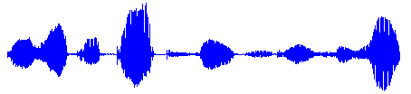

Structured Learning - Beyond Classification
f
“大家好，歡迎大家來修機器學習”
Speech Recognition
“機器學習”
f
“Machine Learning”
Machine Translation
春日
實玖瑠
長門
人臉辨識
Notes:
1、Introduction of this course
01_introduction.pptx
参考书
“Machine Learning” (ML) 和 “Machine Learning and having it Deep and Structured” (MLDS) 有何不同？
Speech Recognition 语音识别
Image Recognition 图像识别
Playing Go 下围棋
Dialogue System 对话系统
Goodness of function f 函数优度 f
Learning Theory 学习理论
scenario 设想
Supervised Learning 监督学习
Semi-supervised Learning 半监督学习
Transfer Learning 迁移学习
Unsupervised Learning 无监督学习
Reinforcement Learning 强化学习
task
Regression 回归
Classification 分类
Structured Learning 结构化学习
method
Linear Model 线性模型
Non-linear Model
Deep Learning 深度学习
SVM, decision tree, K-NN … SVM、决策树、K-NN……
Regression
The output of the target function $f$ is “scalar”.
Binary Classification 二元分类
Multi-class Classification 多类分类
Spam filtering 垃圾邮件过滤
Document Classification 文档分类
Hierarchical Structure 层次结构
需要注意下围棋的训练数据的组织形式
半监督学习和迁移学习的区别是同样是猫狗分类的任务，
半监督学习使用的全部是猫和狗的图片，只不过有一部分图片没有标签，
迁移学习除了使用猫和狗的图片，还使用了其他图片，这些图片和猫狗无关
Data not related to the task considered (can be either labeled or unlabeled) 与考虑的任务无关的数据（可以标记或不标记）
Machine Reading: Machine learns the meaning of words from reading a lot of documents without supervision 机器阅读：机器无需监督，通过阅读大量文档来学习单词的含义
Beyond Classification 超越分类
Speech Recognition 语音识别—没有办法穷举声音可能得所有输出
Machine Translation 机器翻译—没有办法穷举所有可能翻译的结构
Convolutional Neural Network (CNN) 卷积神经网络（CNN）
Learning from critics 向批评家学习

Slide 35
Learning Map
Semi-supervised Learning
Transfer Learning
Regression
Unsupervised Learning
Reinforcement Learning
Linear Model
Deep Learning
SVM, decision tree, K-NN …
Structured Learning
Non-linear Model
Classification
Supervised Learning
Notes:
1、Introduction of this course
01_introduction.pptx
参考书
“Machine Learning” (ML) 和 “Machine Learning and having it Deep and Structured” (MLDS) 有何不同？
Speech Recognition 语音识别
Image Recognition 图像识别
Playing Go 下围棋
Dialogue System 对话系统
Goodness of function f 函数优度 f
Learning Theory 学习理论
scenario 设想
Supervised Learning 监督学习
Semi-supervised Learning 半监督学习
Transfer Learning 迁移学习
Unsupervised Learning 无监督学习
Reinforcement Learning 强化学习
task
Regression 回归
Classification 分类
Structured Learning 结构化学习
method
Linear Model 线性模型
Non-linear Model
Deep Learning 深度学习
SVM, decision tree, K-NN … SVM、决策树、K-NN……
Regression
The output of the target function $f$ is “scalar”.
Binary Classification 二元分类
Multi-class Classification 多类分类
Spam filtering 垃圾邮件过滤
Document Classification 文档分类
Hierarchical Structure 层次结构
需要注意下围棋的训练数据的组织形式
半监督学习和迁移学习的区别是同样是猫狗分类的任务，
半监督学习使用的全部是猫和狗的图片，只不过有一部分图片没有标签，
迁移学习除了使用猫和狗的图片，还使用了其他图片，这些图片和猫狗无关
Data not related to the task considered (can be either labeled or unlabeled) 与考虑的任务无关的数据（可以标记或不标记）
Machine Reading: Machine learns the meaning of words from reading a lot of documents without supervision 机器阅读：机器无需监督，通过阅读大量文档来学习单词的含义
Beyond Classification 超越分类
Speech Recognition 语音识别—没有办法穷举声音可能得所有输出
Machine Translation 机器翻译—没有办法穷举所有可能翻译的结构
Convolutional Neural Network (CNN) 卷积神经网络（CNN）
Learning from critics 向批评家学习

Slide 36
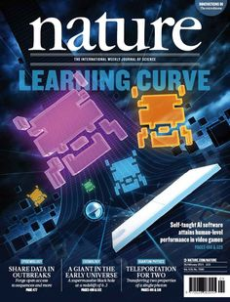

Reinforcement Learning
Notes:
1、Introduction of this course
01_introduction.pptx
参考书
“Machine Learning” (ML) 和 “Machine Learning and having it Deep and Structured” (MLDS) 有何不同？
Speech Recognition 语音识别
Image Recognition 图像识别
Playing Go 下围棋
Dialogue System 对话系统
Goodness of function f 函数优度 f
Learning Theory 学习理论
scenario 设想
Supervised Learning 监督学习
Semi-supervised Learning 半监督学习
Transfer Learning 迁移学习
Unsupervised Learning 无监督学习
Reinforcement Learning 强化学习
task
Regression 回归
Classification 分类
Structured Learning 结构化学习
method
Linear Model 线性模型
Non-linear Model
Deep Learning 深度学习
SVM, decision tree, K-NN … SVM、决策树、K-NN……
Regression
The output of the target function $f$ is “scalar”.
Binary Classification 二元分类
Multi-class Classification 多类分类
Spam filtering 垃圾邮件过滤
Document Classification 文档分类
Hierarchical Structure 层次结构
需要注意下围棋的训练数据的组织形式
半监督学习和迁移学习的区别是同样是猫狗分类的任务，
半监督学习使用的全部是猫和狗的图片，只不过有一部分图片没有标签，
迁移学习除了使用猫和狗的图片，还使用了其他图片，这些图片和猫狗无关
Data not related to the task considered (can be either labeled or unlabeled) 与考虑的任务无关的数据（可以标记或不标记）
Machine Reading: Machine learns the meaning of words from reading a lot of documents without supervision 机器阅读：机器无需监督，通过阅读大量文档来学习单词的含义
Beyond Classification 超越分类
Speech Recognition 语音识别—没有办法穷举声音可能得所有输出
Machine Translation 机器翻译—没有办法穷举所有可能翻译的结构
Convolutional Neural Network (CNN) 卷积神经网络（CNN）
Learning from critics 向批评家学习

Slide 37


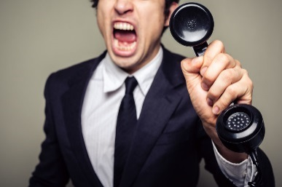
Supervised v.s. Reinforcement
Supervised
Reinforcement
“Hello”
Say “Hi”
Learning from teacher
“Bye bye”
Say “Good bye”
…….
…….
……
Hello ☺
……
Bad
Learning from critics
Agent
Agent
Notes:
1、Introduction of this course
01_introduction.pptx
参考书
“Machine Learning” (ML) 和 “Machine Learning and having it Deep and Structured” (MLDS) 有何不同？
Speech Recognition 语音识别
Image Recognition 图像识别
Playing Go 下围棋
Dialogue System 对话系统
Goodness of function f 函数优度 f
Learning Theory 学习理论
scenario 设想
Supervised Learning 监督学习
Semi-supervised Learning 半监督学习
Transfer Learning 迁移学习
Unsupervised Learning 无监督学习
Reinforcement Learning 强化学习
task
Regression 回归
Classification 分类
Structured Learning 结构化学习
method
Linear Model 线性模型
Non-linear Model
Deep Learning 深度学习
SVM, decision tree, K-NN … SVM、决策树、K-NN……
Regression
The output of the target function $f$ is “scalar”.
Binary Classification 二元分类
Multi-class Classification 多类分类
Spam filtering 垃圾邮件过滤
Document Classification 文档分类
Hierarchical Structure 层次结构
需要注意下围棋的训练数据的组织形式
半监督学习和迁移学习的区别是同样是猫狗分类的任务，
半监督学习使用的全部是猫和狗的图片，只不过有一部分图片没有标签，
迁移学习除了使用猫和狗的图片，还使用了其他图片，这些图片和猫狗无关
Data not related to the task considered (can be either labeled or unlabeled) 与考虑的任务无关的数据（可以标记或不标记）
Machine Reading: Machine learns the meaning of words from reading a lot of documents without supervision 机器阅读：机器无需监督，通过阅读大量文档来学习单词的含义
Beyond Classification 超越分类
Speech Recognition 语音识别—没有办法穷举声音可能得所有输出
Machine Translation 机器翻译—没有办法穷举所有可能翻译的结构
Learning from critics 向批评家学习
Convolutional Neural Network (CNN) 卷积神经网络（CNN）

Slide 38

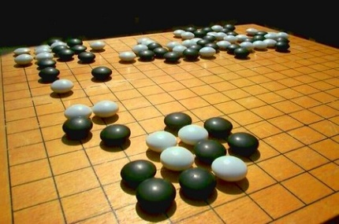
Supervised v.s. Reinforcement
Supervised:
Reinforcement Learning
Next move:
“5-5”
Next move:
“3-3”
First move
…… many moves ……
Win!
Alpha Go is supervised learning + reinforcement learning.
Notes:
1、Introduction of this course
01_introduction.pptx
参考书
“Machine Learning” (ML) 和 “Machine Learning and having it Deep and Structured” (MLDS) 有何不同？
Speech Recognition 语音识别
Image Recognition 图像识别
Playing Go 下围棋
Dialogue System 对话系统
Goodness of function f 函数优度 f
Learning Theory 学习理论
scenario 设想
Supervised Learning 监督学习
Semi-supervised Learning 半监督学习
Transfer Learning 迁移学习
Unsupervised Learning 无监督学习
Reinforcement Learning 强化学习
task
Regression 回归
Classification 分类
Structured Learning 结构化学习
method
Linear Model 线性模型
Non-linear Model
Deep Learning 深度学习
SVM, decision tree, K-NN … SVM、决策树、K-NN……
Regression
The output of the target function $f$ is “scalar”.
Binary Classification 二元分类
Multi-class Classification 多类分类
Spam filtering 垃圾邮件过滤
Document Classification 文档分类
Hierarchical Structure 层次结构
需要注意下围棋的训练数据的组织形式
半监督学习和迁移学习的区别是同样是猫狗分类的任务，
半监督学习使用的全部是猫和狗的图片，只不过有一部分图片没有标签，
迁移学习除了使用猫和狗的图片，还使用了其他图片，这些图片和猫狗无关
Data not related to the task considered (can be either labeled or unlabeled) 与考虑的任务无关的数据（可以标记或不标记）
Machine Reading: Machine learns the meaning of words from reading a lot of documents without supervision 机器阅读：机器无需监督，通过阅读大量文档来学习单词的含义
Beyond Classification 超越分类
Speech Recognition 语音识别—没有办法穷举声音可能得所有输出
Machine Translation 机器翻译—没有办法穷举所有可能翻译的结构
Learning from critics 向批评家学习
Convolutional Neural Network (CNN) 卷积神经网络（CNN）

Slide 39
Learning Map
scenario
task
method
Learning Theory
Semi-supervised Learning
Transfer Learning
Regression
Unsupervised Learning
Reinforcement Learning
Linear Model
Deep Learning
SVM, decision tree, K-NN …
Structured Learning
Non-linear Model
Classification
Supervised Learning
Notes:
1、Introduction of this course
01_introduction.pptx
参考书
“Machine Learning” (ML) 和 “Machine Learning and having it Deep and Structured” (MLDS) 有何不同？
Speech Recognition 语音识别
Image Recognition 图像识别
Playing Go 下围棋
Dialogue System 对话系统
Goodness of function f 函数优度 f
Learning Theory 学习理论
scenario 设想
Supervised Learning 监督学习
Semi-supervised Learning 半监督学习
Transfer Learning 迁移学习
Unsupervised Learning 无监督学习
Reinforcement Learning 强化学习
task
Regression 回归
Classification 分类
Structured Learning 结构化学习
method
Linear Model 线性模型
Non-linear Model
Deep Learning 深度学习
SVM, decision tree, K-NN … SVM、决策树、K-NN……
Regression
The output of the target function $f$ is “scalar”.
Binary Classification 二元分类
Multi-class Classification 多类分类
Spam filtering 垃圾邮件过滤
Document Classification 文档分类
Hierarchical Structure 层次结构
需要注意下围棋的训练数据的组织形式
半监督学习和迁移学习的区别是同样是猫狗分类的任务，
半监督学习使用的全部是猫和狗的图片，只不过有一部分图片没有标签，
迁移学习除了使用猫和狗的图片，还使用了其他图片，这些图片和猫狗无关
Data not related to the task considered (can be either labeled or unlabeled) 与考虑的任务无关的数据（可以标记或不标记）
Machine Reading: Machine learns the meaning of words from reading a lot of documents without supervision 机器阅读：机器无需监督，通过阅读大量文档来学习单词的含义
Beyond Classification 超越分类
Speech Recognition 语音识别—没有办法穷举声音可能得所有输出
Machine Translation 机器翻译—没有办法穷举所有可能翻译的结构
Learning from critics 向批评家学习
Convolutional Neural Network (CNN) 卷积神经网络（CNN）

Slide 40

Why we need to learn Machine Learning?
http://www.express.co.uk/news/science/651202/First-step-towards-The-Terminator-becoming-reality-AI-beats-champ-of-world-s-oldest-game
AI 即將取代部分的工作?
新工作：AI 訓練師
Notes:
1、Introduction of this course
01_introduction.pptx
参考书
“Machine Learning” (ML) 和 “Machine Learning and having it Deep and Structured” (MLDS) 有何不同？
Speech Recognition 语音识别
Image Recognition 图像识别
Playing Go 下围棋
Dialogue System 对话系统
Goodness of function f 函数优度 f
Learning Theory 学习理论
scenario 设想
Supervised Learning 监督学习
Semi-supervised Learning 半监督学习
Transfer Learning 迁移学习
Unsupervised Learning 无监督学习
Reinforcement Learning 强化学习
task
Regression 回归
Classification 分类
Structured Learning 结构化学习
method
Linear Model 线性模型
Non-linear Model
Deep Learning 深度学习
SVM, decision tree, K-NN … SVM、决策树、K-NN……
Regression
The output of the target function $f$ is “scalar”.
Binary Classification 二元分类
Multi-class Classification 多类分类
Spam filtering 垃圾邮件过滤
Document Classification 文档分类
Hierarchical Structure 层次结构
需要注意下围棋的训练数据的组织形式
半监督学习和迁移学习的区别是同样是猫狗分类的任务，
半监督学习使用的全部是猫和狗的图片，只不过有一部分图片没有标签，
迁移学习除了使用猫和狗的图片，还使用了其他图片，这些图片和猫狗无关
Data not related to the task considered (can be either labeled or unlabeled) 与考虑的任务无关的数据（可以标记或不标记）
Machine Reading: Machine learns the meaning of words from reading a lot of documents without supervision 机器阅读：机器无需监督，通过阅读大量文档来学习单词的含义
Beyond Classification 超越分类
Speech Recognition 语音识别—没有办法穷举声音可能得所有输出
Machine Translation 机器翻译—没有办法穷举所有可能翻译的结构
Learning from critics 向批评家学习
Convolutional Neural Network (CNN) 卷积神经网络（CNN）

Slide 41

AI 訓練師
機器不是自己會學嗎？
為什麼需要 AI 訓練師
戰鬥是寶可夢在打，
為什麼需要寶可夢訓練師？

Slide 42

神奇寶貝第5集 尼比市的決鬥
https://www.youtube.com/watch?v=uUOZZb8eJ_k

Slide 43
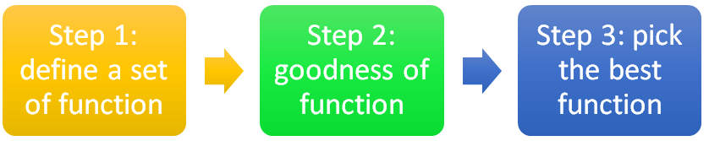
AI 訓練師
寶可夢訓練師
AI 訓練師
寶可夢訓練師要挑選適合的寶可夢來戰鬥
寶可夢有不同的屬性
AI訓練師要挑選合適的 model, loss function
不同 model, loss function 適合解決不同的問題

Slide 44
神奇寶貝第106集 噴火龍‧就決定是你了
https://www.youtube.com/watch?v=4G_aoKiCDc4

Slide 45
AI 訓練師
寶可夢訓練師
AI 訓練師
寶可夢訓練師要挑選適合的寶可夢來戰鬥
寶可夢有不同的屬性
召喚出來的寶可夢不一定聽話
E.g. 小智的噴火龍
需要有經驗的寶可夢訓練師
AI訓練師要挑選合適的 model, loss function
不同 model, loss function 適合解決不同的問題
不一定能找出 best function
E.g. Deep Learning
需要有經驗的 AI 訓練師

Slide 46
大家還記得寶可夢的開場嗎？
https://www.youtube.com/watch?v=NyCNkq4ByzY

Slide 47
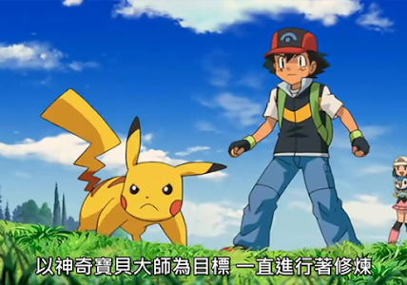
AI 訓練師
http://www.gvm.com.tw/webonly_content_10787.html
厲害的 AI ， AI 訓練師功不可沒
讓我們一起朝 AI 訓練師之路邁進

